Slide 1
FACEFEEL-A SYSTEM FOR REAL-TIME EMOTION RECOGNITION
SHREYA MODI 3BR22CS156
SHRIDEVI 3BR22CS158
SNEHA DEVALE 3BR22CS164
TEJASHWINI VR 3BR22CS173

Slide 2
ABSTRACT
Emotion detection is pivotal in enhancing human-computer interaction by enabling systems to interpret human behaviour effectively. This mini-project aims to develop a system that identifies human emotions using computer vision and machine learning techniques. The system processes visual inputs to detect facial expressions translating them into corresponding emotions. Using tools like OpenCV, TensorFlow, and pre-trained deep learning models, the project combines feature extraction with real-time data processing. Applications of this work include areas such as interactive gaming, assistive technologies, and user experience enhancement. This project provides a foundation for integrating human-like perceptual capabilities into intelligent systems, bridging the gap between humans and machines.

Slide 3
OBJECTIVES
To enhance communication between humans and machines by understanding emotions.
To personalize user experiences by tailoring responses based on emotional cues.
To improve the accuracy of detecting emotions in various environments.

Slide 4
LITERATURE SURVEY:
Ref. No. | Author | Title | contribution | observation
[1] | J. Wakefield | Facial recognition tech: AI to detect emotions during job interviews | Jerome Wakefield critiques the medicalization of emotions, stressing that emotion detection systems should differentiate normal emotions from mental health issues. | Advanced sensors are essential for improving system accuracy and user engagement.
[2] | R. Smith | Network Rail 'secretly used AI to read passengers' emotions' | Ryan Smith's work on emotion detection includes models of emotional inference, training to enhance recognition skills, and studying sex differences. | Observations showing training improves awareness and recognition abilities.
[3] | J. Halpern | AI-powered smart glasses monitor your emotions and habits | J.Halpern's work contributes to understanding emotion detection in stress management, emphasizing emotional awareness and secure attachments, | Faces challenges like limited emotion recognition, reliance on self-reports, and context-specific findings.
[4] | S. Perez | AI systems can now detect human emotions in real-time | S. Pérez's research contributes to emotion detection by developing physiological signal processing methods to decode emotional experiences, achieving high recognition accuracy through innovative classification approaches. | However, challenges include managing the complexity of multimodal data and ensuring the generalizability of models across diverse populations.

Slide 5
PROBLEM STATEMENT
To develop and design a real-time system using machine learning that accurately recognizes and interprets human emotions from facial expressions for improved human-computer interaction.

Slide 6
SCOPE OF THE PROJECT
To focus on real-time emotion detection from live facial expressions, the system is designed for applications like interactive systems and real-time analysis. However, it cannot process or recognize emotions from pre-recorded images or videos, limiting its use to live interactions only.

Slide 7
SOFTWARE REQIREMENTS
Python (3.6 or higher): Required for compatibility with modern libraries and functionality.
OpenCV (4.5.1 or higher): Needed for image and video processing, including frame capture and display.
FER (1.0.0 or higher): Provides the emotion detection model for facial expression analysis.
NumPy (1.18.5 or higher): Handles array manipulation and mathematical operations efficiently for FER.

Slide 8
HARDWARE REQUIREMENTS
Camera: A webcam or external camera is required to capture real-time facial expressions for emotion detection.
CPU: A processor with at least 2 cores (Intel i3 or equivalent) is needed for smooth execution of the emotion detection algorithm.
RAM: A minimum of 4 GB of RAM is recommended for handling video frame processing and emotion detection tasks.
Storage: At least 100 MB of available storage for the software and libraries.
Operating System: Windows, macOS, or Linux (Ubuntu recommended) that supports Python, OpenCV, and other required libraries for emotion detection.

Slide 9
FUNCTIONAL REQUIREMENTS
Real-time Video Capture: The system must capture live video feed from the connected camera.
Emotion Detection: It must detect and analyze emotions from the faces in the captured video frames.
Display bounding box: A bounding box should be drawn around detected faces to highlight the area of interest.
Display Video: The processed video with bounding boxes and detected emotions should be displayed in real-time.
Exit mechanism: The system must allow the user to terminate the application gracefully using a defined key or command.

Slide 10
NON-FUNCTIONAL REQUIREMENTS
Scalability : The system should handle multiple faces in real-time without significant performance degradation.
Usability : The interface must be user-friendly, allowing easy interaction and understanding of outputs.
Compatibility : It should run smoothly on different operating systems (Windows, macOS, Linux) and hardware setups.
Performance : The system must process and display video frames with minimal latency for a seamless experience.
Error handling : It should detect and handle errors, such as camera disconnection or invalid inputs, gracefully without crashing.

Slide 11
DESCRIPTION OF MODULES
Real-Time Video Capture: Captures live video feed from the camera.
Emotion Detection: Analyzes facial expressions to detect emotions.
Bounding Box Display: Highlights faces and displays detected emotions.
Video Display: Shows the processed video with real-time updates.
Exit Mechanism: Enables the user to close the application using a specific command.

Slide 12
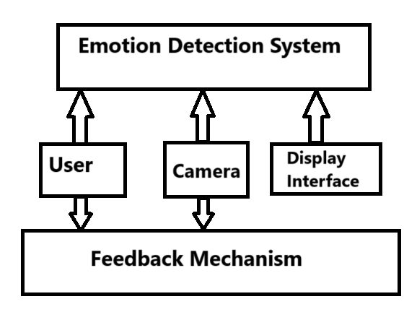
CONTEXT DIAGRAM
Fig1:CONTEXT DIAGRAM

Slide 13
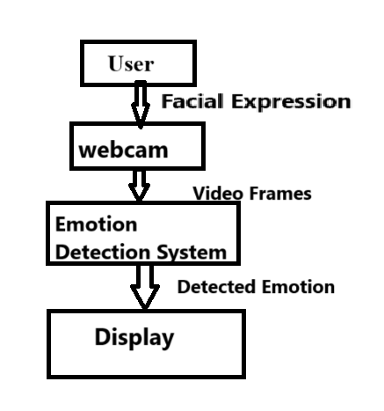
DATA FLOW(LEVEL 0)
Fig2: DATA FLOW(LEVEL 0)

Slide 14
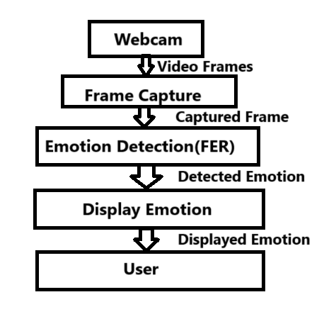
DATA FLOW(LEVEL 1)
Fig3: DATA FLOW(LEVEL 1)

Slide 15
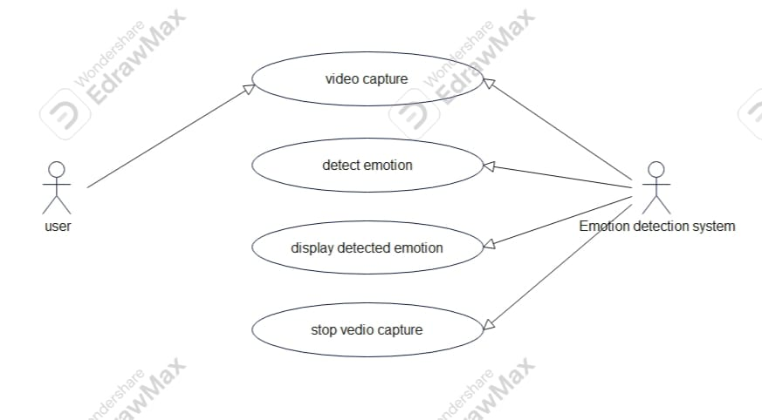
USE CASE DIAGRAM
Fig4: USE CASE DIAGRAM

Slide 16
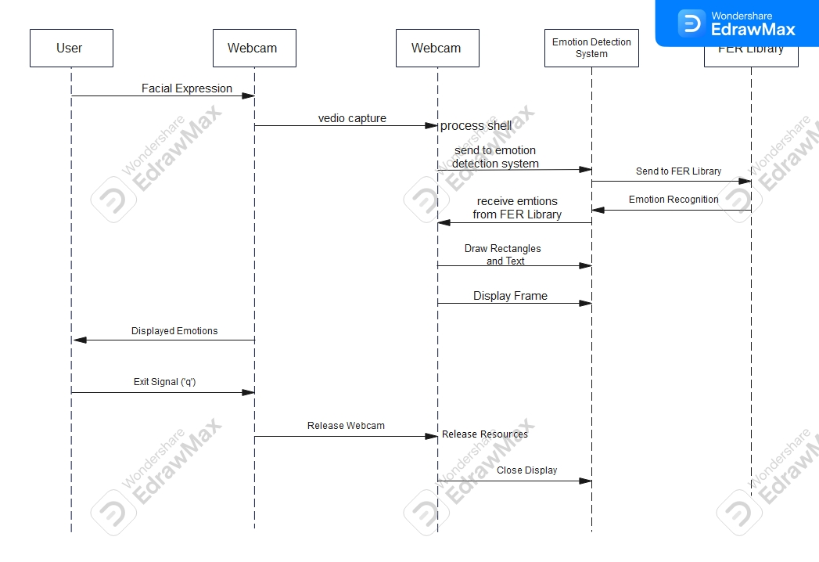
SEQUENCE DIAGRAM
Fig5: SEQUENCE DIAGRAM

Slide 17
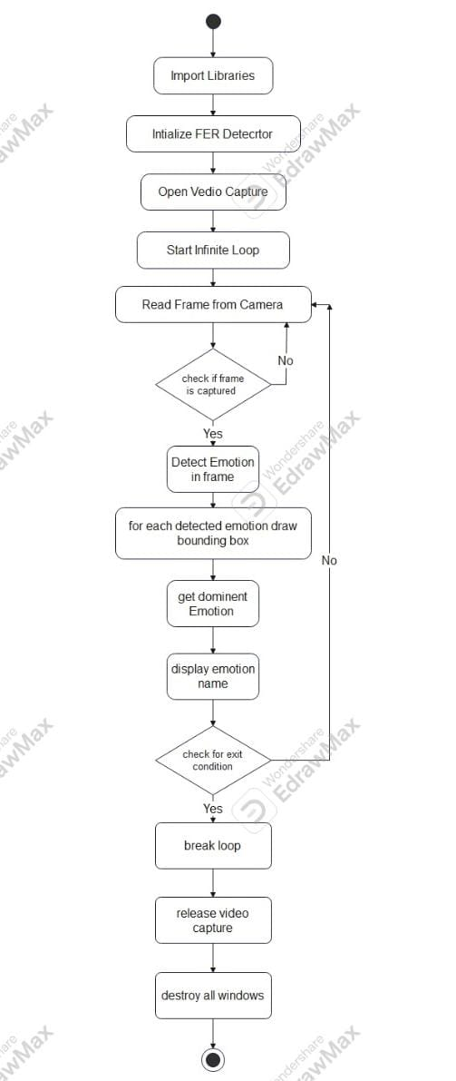
ACTIVITY DIAGRAM
Fig6: ACTIVITY DIAGRAM

Slide 18
IMPLEMENTATION
The implementation involves capturing real-time video using a camera, processing each frame with the FER library to detect emotions, drawing bounding boxes around faces, labeling them with the identified emotion, and displaying the processed video. The program runs in a loop until the user exits by pressing 'q'.

Slide 19
TESTING
Testing is a crucial step to ensure the reliability, accuracy, and real-time performance of your emotion detection system.
Types of testing:
Functional testing
Performance testing
Usability testing
Robustness testing
Integration testing
Edge case testing

Slide 20
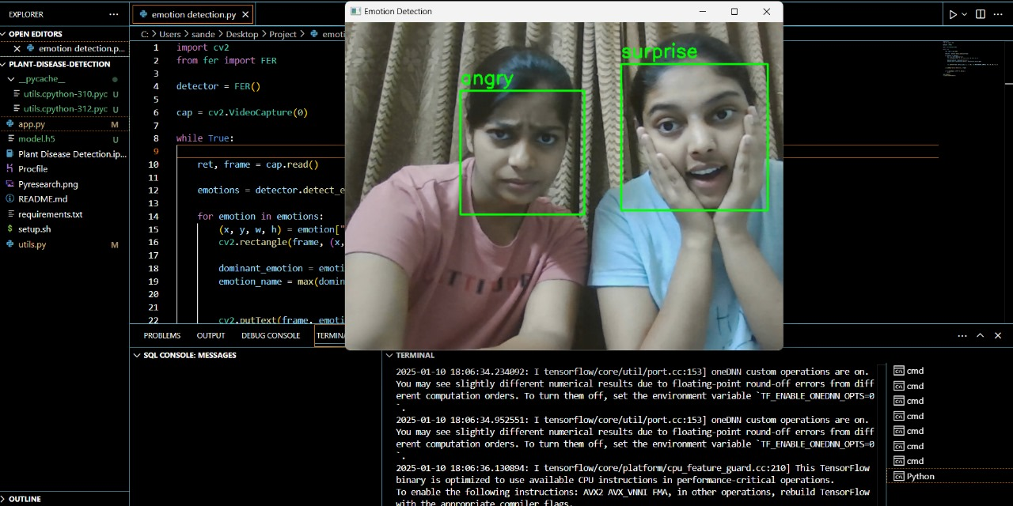
RESULT 1

Slide 21
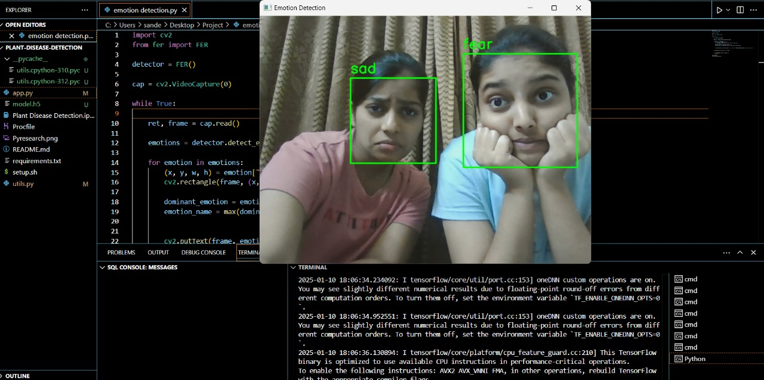
RESULT 2

Slide 22
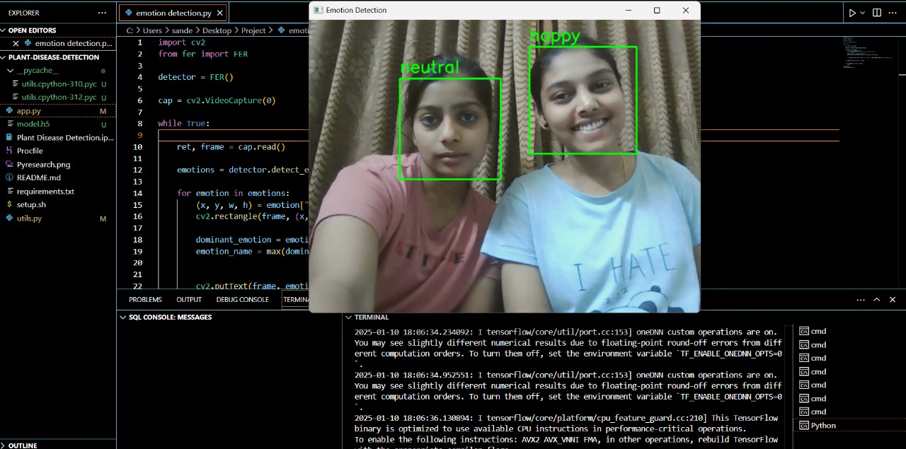
RESULT 3

Slide 23
CONCLUSION
The program demonstrates how to use facial expression recognition to identify and display emotions in real time. It leverages computer vision tools to interactively analyze facial expressions from video, making it suitable for applications requiring real-time feedback on emotional states.
With further optimizations and customization, this setup could be extended to more complex use cases like emotion-driven content adaptation, interactive AI systems, or as a component of an automated monitoring system.

Slide 24
REFERENCES
[1] J. Wakefield, "Facial recognition tech: AI to detect emotions during job interviews," BBC News, Jan. 15, 2024. [Online]. Available: https://www.bbc.com/news
[2] R. Smith, "Network Rail 'secretly used AI to read passengers' emotions'," The Times, Jun. 2024. [Online]. Available: https://www.thetimes.co.uk
[3] J. Halpern, "AI-powered smart glasses monitor your emotions and habits," Business Insider, Oct. 2024. [Online]. Available: https://www.businessinsider.com
[4] S. Perez, "AI systems can now detect human emotions in real-time," The Guardian, Mar. 2024. [Online]. Available: https://www.theguardian.com

Slide 25
THANK YOU

